Slide 1
PY620-Class 4
Inferential stats.
Samples and Populations
Sample statistics and Population parameters.
Hypothesis testing.
Standard deviation and standard error.
Z-test
Rationale behind significance testing.
Signal to Noise.
Errors, errors, and more errors.
Type I error.
Type II error.
Power.
Effect Size.
Confidence Intervals.

Slide 2
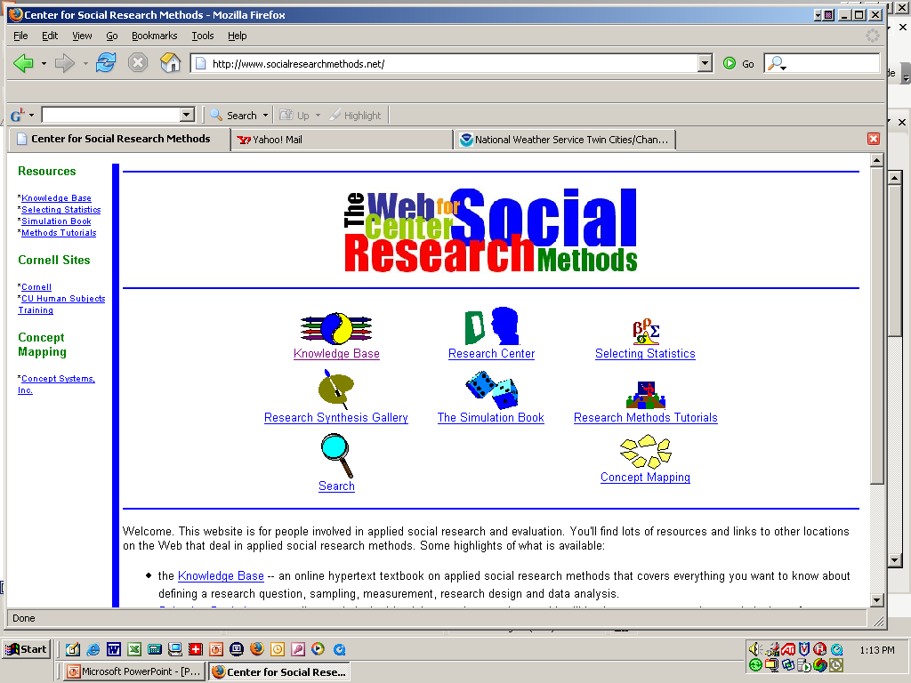
A Helpful Website on Research Methods
Bill Trochim's Center for Social Research Methods website is a very helpful source of information on research methods.

Slide 3
Inferential Statistics: a Definition Revisited.
Inferential Statistics are used to determine the probability (or likelihood) that a conclusion based on analysis from a sample is true.
All measurement contains random error.
We need to take this random error into account when we are trying to say something about a population based on a sample.
High School graduating class. Would a random sample of 10 students characterize your HS class as well as a random sample of 50? Maybe, but probably not.

Slide 4
Difference between Samples and Populations.
The sample describes those individuals who are in a study; the population describes the hypothetical (and usually) infinite number of people to whom you wish to generalize.
Defining the population of interest is very important. Only if the population is well defined can you successfully sample from it.

Slide 5
Selecting the Research Participants
Typically use opportunity samples if goal is simply to learn about human nature.
But what if you want to generalize results from the sample to a population?
Need way of selecting a sample that is representative of the population.

Slide 6

Why is sampling important?
This is why.

Slide 7
What is sampling?
The process of selecting units from a population so that by studying the sample we can generalize to that population.

Slide 8
Sampling Terminology
Population-in theory, the group to whom you want to generalize.
Study population- the group that you can actually get access to.
Sampling frame-how you access that population.
Sample- those you select for your study (not necessarily the same as the people in your study).

Slide 9
Sampling types
Probability sampling.
Simple random samples.
Stratified random samples.
Area probability sampling.
Non Probability sampling.
Convenience sampling.
Purposive sampling.
Snowball sampling.

Slide 10
Simple Random Sampling
Sample is selected from an undivided population.
Sample is chosen using a process that gives every sampling unit an equal chance of being selected.
Requires knowledge of the existence of all the units in the population.

Slide 11
Examples of Random Sampling Strategies
Throwing dice
Using a table of random digits
Spinning a roulette wheel
Drawing capsules from an urn
Using random digit dialing for telephone surveys.

Slide 12
Random Sampling Options
Sampling with replacement
Selected names are placed back in the selection pool.
Exactly the same odds of selection for each unit but a unit may be chosen more than once.
Sampling without replacement
Selected names are discarded and cannot be reselected.
All selection can be done at once, but odds will change as population decreases with selection.

Slide 13
Other Probability Sampling Plans
Stratified random sampling
Create homogeneous subpopulations based on a known characteristic
Area probability sampling
Divide the population into geographic areas

Slide 14
Point Estimates and Confidence Intervals
Point Estimate: Describes some particular characteristic of the population.
Interval Estimate: Indicates how much the point estimates are likely to be in error.
Confidence Interval: Probability that a point estimate is within plus-or-minus some specified interval.

Slide 15
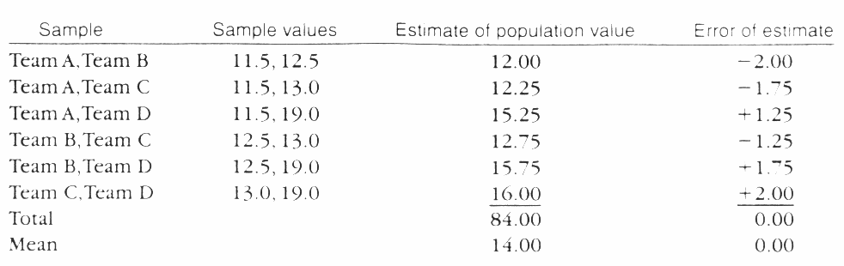
Benefits of Stratification: If Simple Random Sampling Is Used
Team A | 11.5
Team B | 12.5
Team C | 13.0
Team D | 19.0
 | 14.0 (true population value)

Slide 16
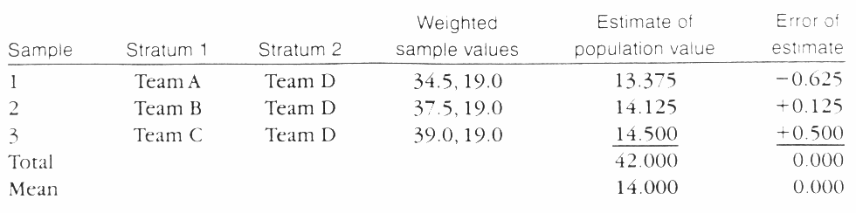
Benefits of Stratification: If Stratified Random Sampling Is Used
Team A | 11.5
Team B | 12.5
Team C | 13.0
Team D | 19.0
 | 14.0 (true population value)

Slide 17
Nonresponse Bias
Error due to nonparticipation or nonresponse.
Possible consequences of this bias:
Smaller effective sample size
Inaccurate estimates of population values

Slide 18
Non-Probability sampling
Convenience. Whoever is convenient and available for your study. Any study which recruits volunteers. Most studies involving college students.
Purposive. Seeks out particular types of people for the sample (e.g. adult female students over 40).Used in marketing surveys.
Snowball. (does not actually involve snow).
A type of purposive sampling that asks people in the sample to name other people like them that they know. Then those people are contacted and asked to name people they know, etc.

Slide 19
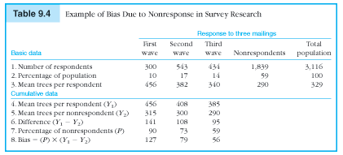
Example of a Nonresponse Bias

Slide 20
Characteristics of Typical Volunteer Subjects
Better educated
Higher social class
Higher IQ scores
Higher need for social approval
More sociable
More arousal-seeking
More unconventional
More often women
Less authoritarian

Slide 21
Excerpt: CBT paper.
Participants
"Participants were 78 clinicians who volunteered to participate in the trial and who provided written informed consent. The participants were required to be currently employed full-time as a clinician treating a predominantly substance-using population. Clinicians were recruited through newsletters and direct contact with clinics. A total of 100 clinicians were initially contacted, 2 were excluded because they were not currently treating substance users, and 20 elected not to participate."

Slide 22
Sampling: CBT paper
What was the population being sampled in the CBT paper?
How did they sample?
Was it random?
How would you draw a random sample from the population of interest?

Slide 23
What the authors said.
“Finally, these findings reflect effects of training on real world clinicians who volunteered to participate in an evaluation of training strategies, and it is not known whether these findings generalize to other, possibly less motivated, groups of clinicians or to other types of treatment.”

Slide 24
When is randomization used?
Random selection is how you draw the sample of people for your study from a population. Random selection is related to sampling which is related to external validity.
Random assignment is how you assign the sample that you draw to different groups or treatments in your study. Random assignment is related to internal validity.

